Slide 1
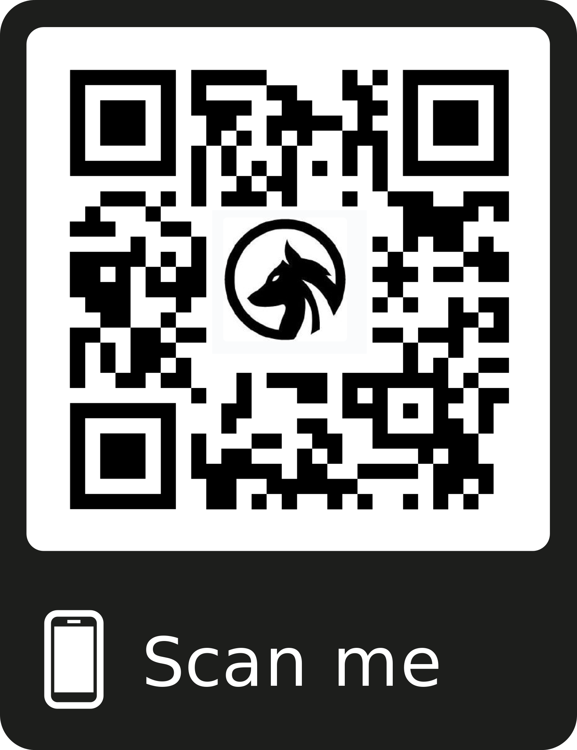
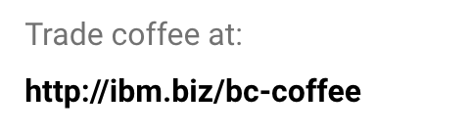

Join a Coffee Blockchain!
Network: Wolfpack
Password:IBMC10ud
Follow @IBMWolfpack
Notes:
Coffee Bean Youtube Video: https://www.youtube.com/watch?v=YOr9A_TygBk&t=213s Demo Admin View: http://blockchain-coffee-web.mybluemix.net/

